Slide 1
Grocery Management System
Chiranjibi Ghimire
Sushil Tiwari

Slide 2
Objective
This project is based on real spending data for three months. Using this data we applied three techniques such as Cluster, Association, and neural network analysis.
We are trying to come up with an answers for the questions listed below.
What are the categories and stores that we frequently purchase our daily stuffs from?
How is our buying pattern.
What are the items that we most likely buy together.
How can we optimize our spending on grocery

Slide 3
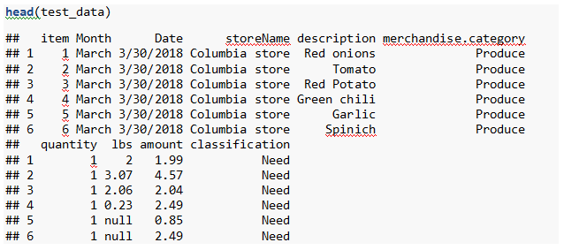
Find a data set
Since the data was prepared by ourselves, we don’t have to scale the data. Our data are in range.
This data collection is based on real shopping activity over three months of period.

Slide 4
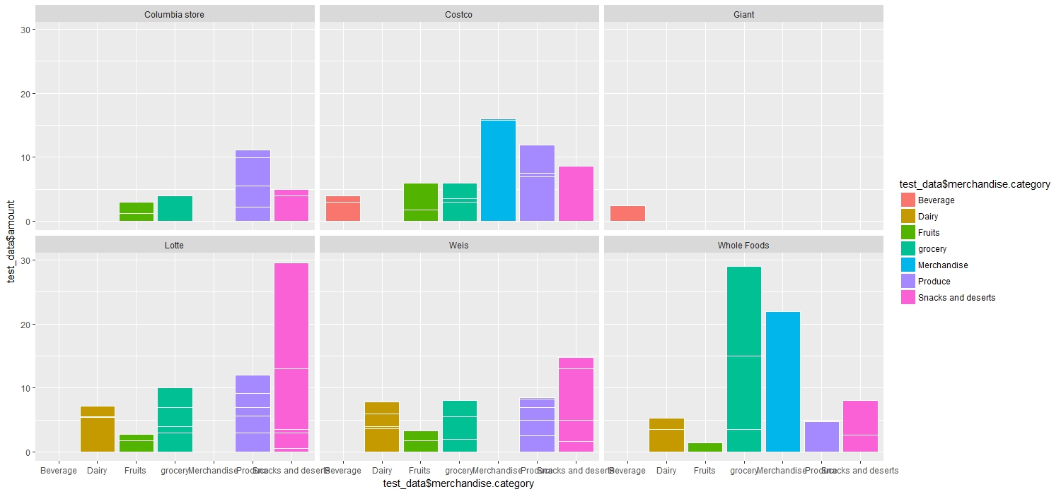

Data Visualization
This is a ggplot of category vs. amount for all stores

Slide 5
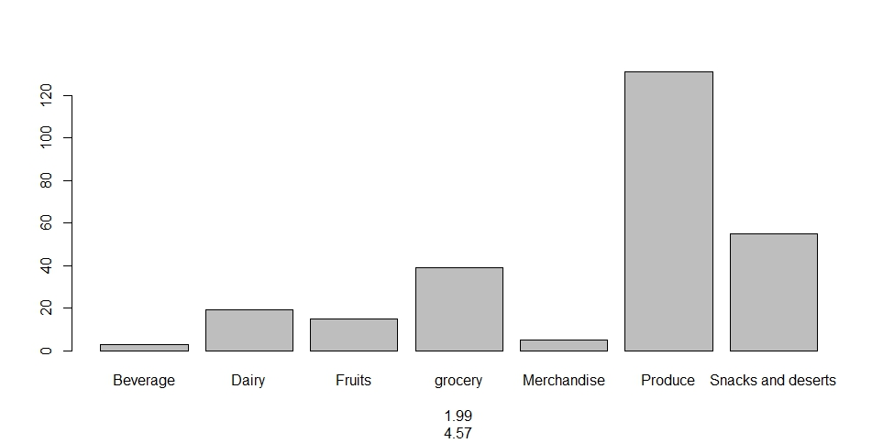
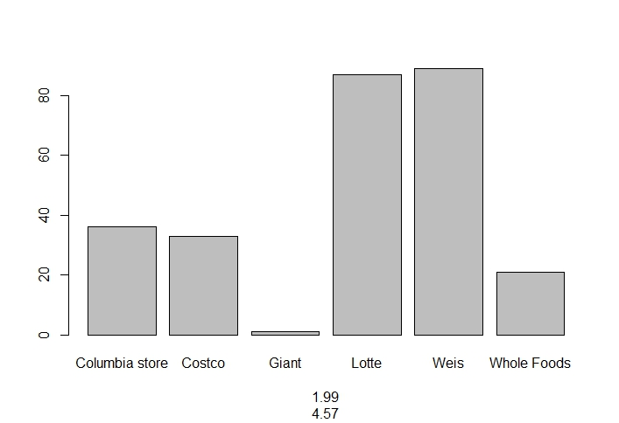
Data Visualization
Upper right is the bar plot of frequency count of category
Lower right plot shows the frequency count of stores

Slide 6
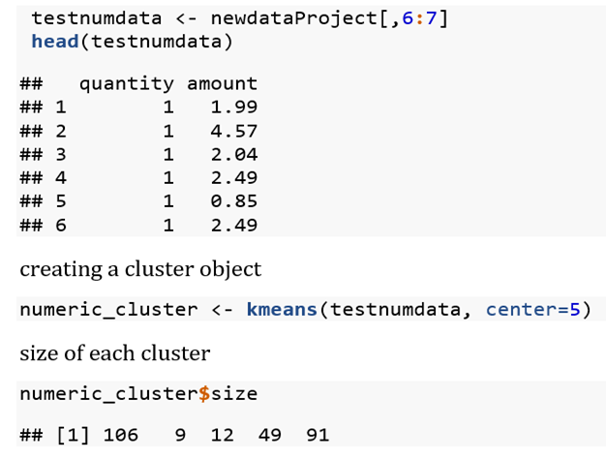
Clustering
K means clustering
Taking numeric column in an object for clustering

Slide 7
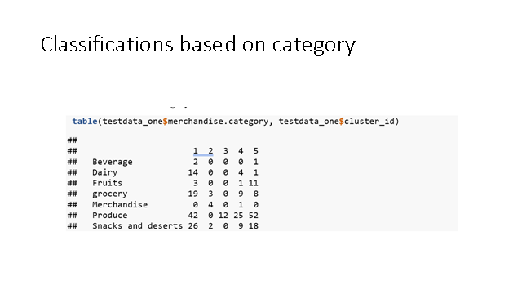

Slide 8
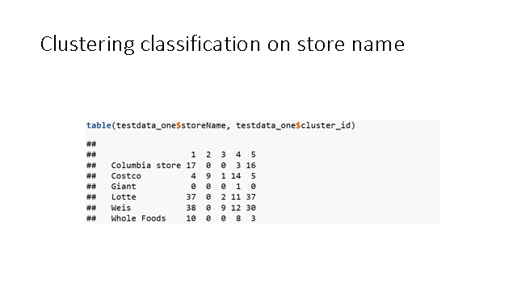

Slide 9
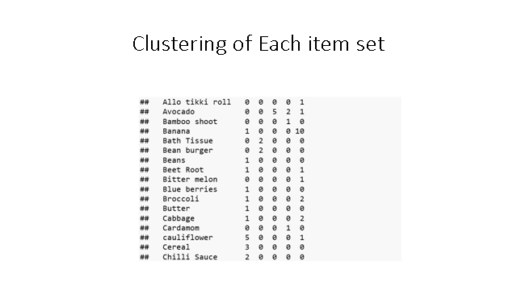

Slide 10
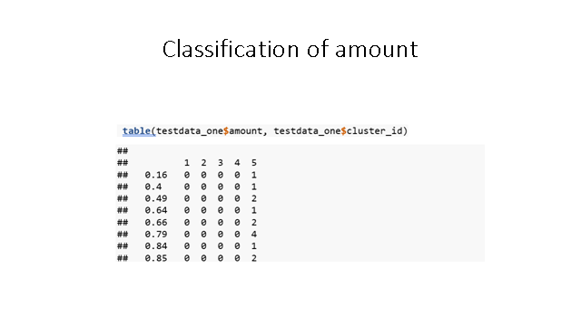

Slide 11
Association Analysis
Data prepared using java
Market Basket Analysis
Each receipt represents each rows in the dataset.

Slide 12
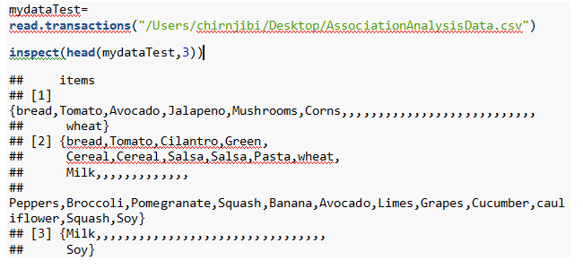
Association Analysis

Slide 13
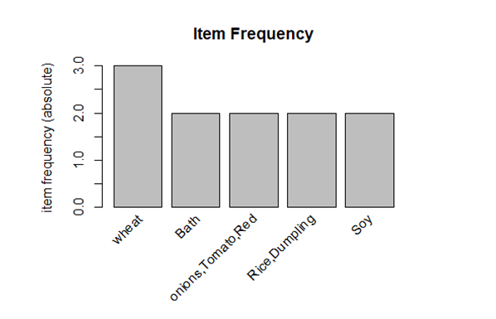
Most Frequent Items
This is a most frequent item of the data based on the support parameter. We set supp=0.1

Slide 14
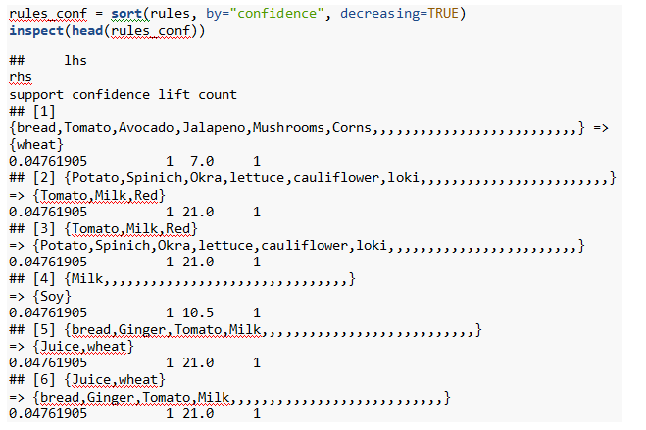
Get Recommendation Rule
Create Association Rules: min support as 0.01, confidence as 0.05
Sorted with ‘high-confidence’ rule
The rules with confidence of 1 imply that, whenever the LHS item was purchased, the RHS item was also purchased 100% of the time.

Slide 15
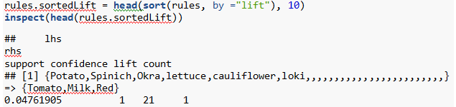
Get Recommendation Rule
10 rules with highest lift: to get strong rules
A rule with a lift of 21 imply that, the items in LHS and RHS are 21 times more likely to be purchased together

Slide 16
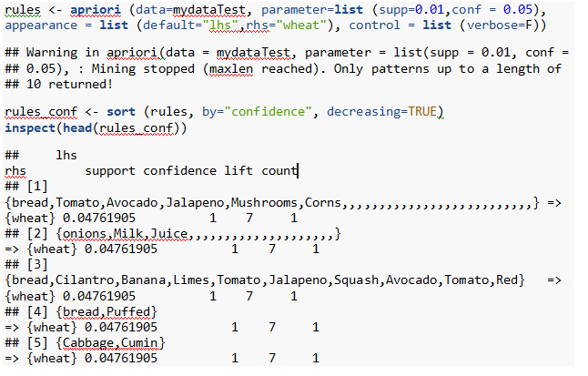
Find Rules Related To Given Item/s-Targeting Items
To find out what we had purchased before buying ‘wheat’. This will help us understand the patterns that led to the purchase of ‘wheat’.

Slide 17
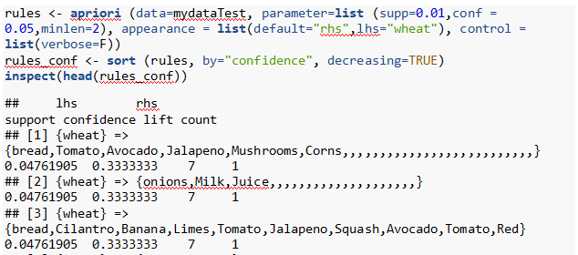
Find Rules Related To Given Item/s
To find out what products were purchased after/along with product ‘wheat’. This is a case to find out when we bought ‘Wheat’ also bought…

Slide 18
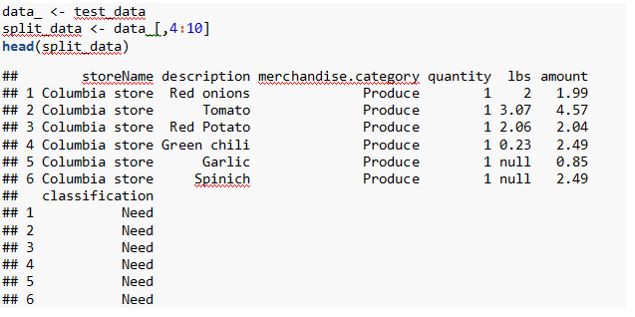
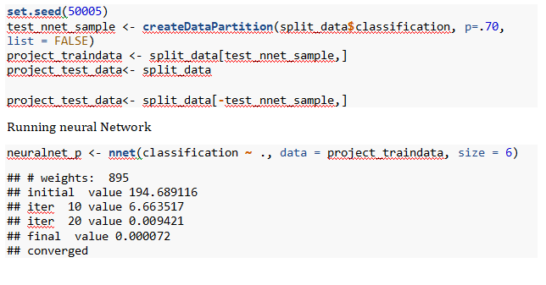
Neural Network
Splitting data to have less weight, will all the columns are throws weight error
Preparing data for training and testing set

Slide 19
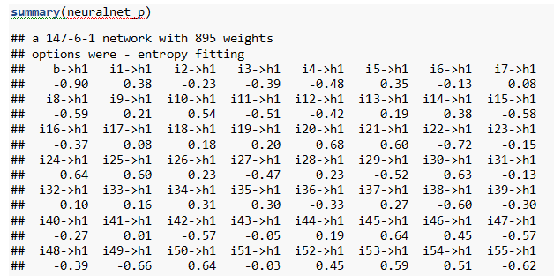
Neural Network
Analyzing the model

Slide 20

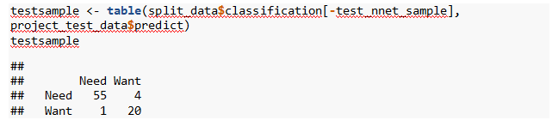
Neural Network
Now adding column to each training and test data to see if the model is fit
Checking the model to see how close we are
Out of 59 Needs 55 were predicted correctly and Out of 21 want 20 were predicted correctly

Slide 21
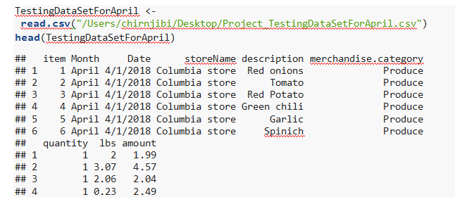
Neural Network
Now we can use the neural net model to predict our spending and optimize our budget loading data for April month

Slide 22
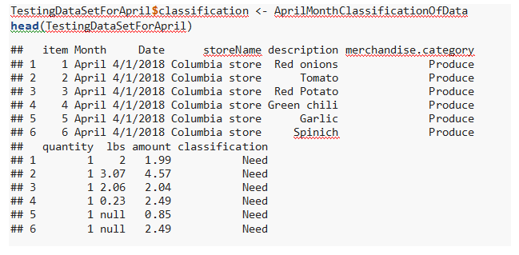
Neural Network
Checking the classification
As we can see when we purchase Red onions from Columbia Store it is classified as our Needs, meaning the Red onion is something we can’t avoid buying
But Sandwich cookie that we bought from Weis is not necessary for us. It’s something we can avoid buying and save some money or spend it on our needs. So by categorizing things to need and wants we can filter or avoid buying unnecessary and unplanned groceries and cut down on our expenses.

Slide 23
Recommendation
Based on our research, Our grocery spending can be optimized
We can also see which items are tied together and check our neural net model to see if that particular item set falls under our needs or wants.
We can avoid our wants and only focus on our needs.

Slide 24


